Slide 1
RECOMMENDATION ENGINE
GROUP 10

Slide 2
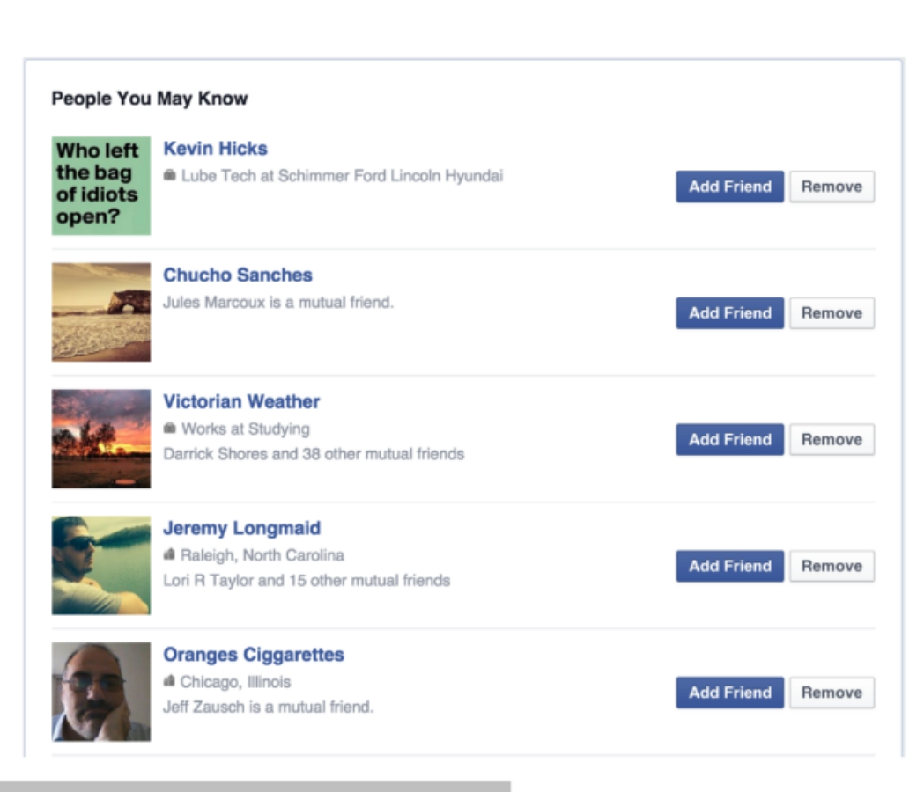

Slide 3
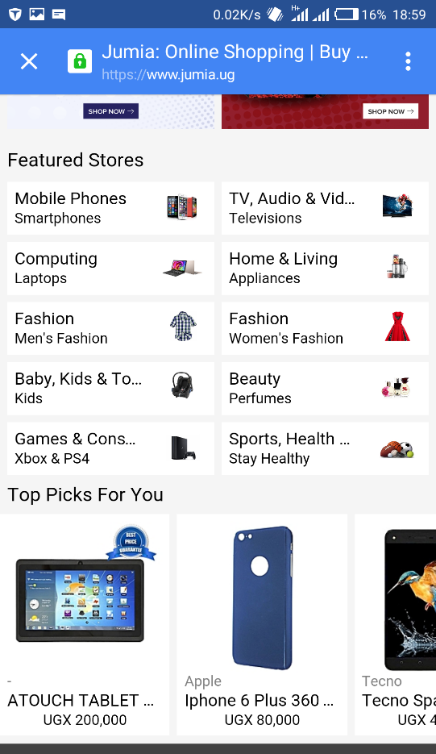
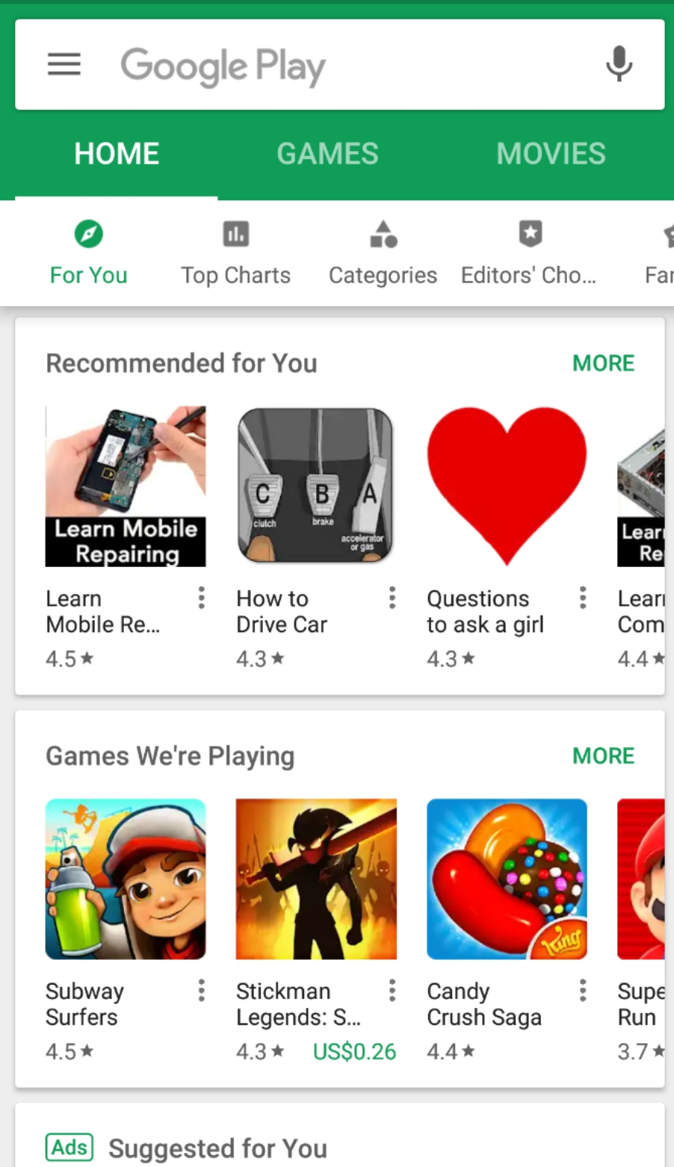

Slide 4
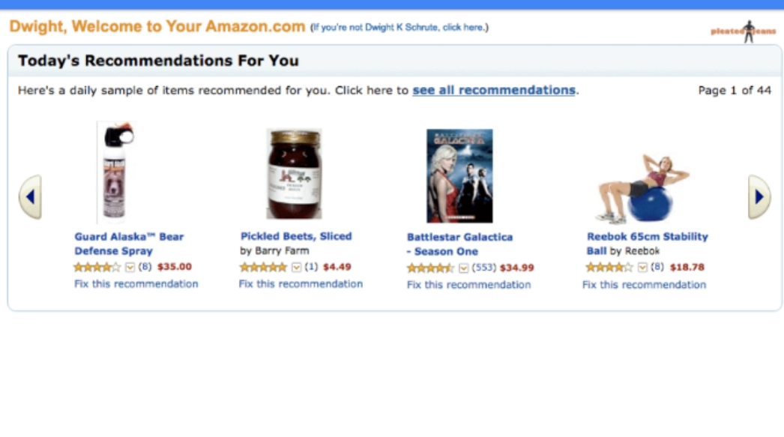

Slide 5
Definition
They are simple algorithms which aim to provide the most relevant and accurate items to the user by filtering useful stuff from a huge pool of information base
Wikipedia defines Recommendation Engine as;
A subclass of information filtering system that seeks to predict the “rating” or “preference” a user would give to an item

Slide 6
Areas where Recommendation Engines are used
Movie streaming and downloads
Music streaming and downloads
News sites
Social sites
Online Shopping
Online dating
etc

Slide 7
Approaches used
1. Collaborative filtering
2. Content Based filtering
3. Hybrid Recommender System

Slide 8
Collaborative filtering
Builds a model from user’s past behavior as well as similar decisions made by other users
A good illustration is;
If a person, A likes item 1, 2, 3 and B likes 2, 3, 4 then they have similar interests: Therefore A should like item 4 and B should like item 1

Slide 9
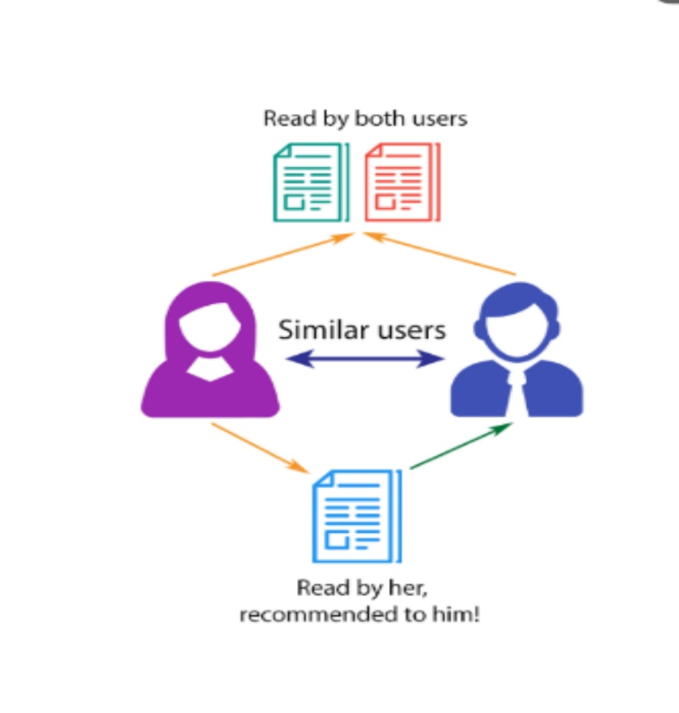
Collaborative filtering (Illustration)

Slide 10
Collaborative filtering is subdivided into two
User based collaborative filtering
Item based collaborative filtering
Problems faced when using collaborative filtering
Cold start
Scalability
Sparsity

Slide 11
Popular sites that use collaborative filtering
Facebook
Myspace
LinkedIn
and other social networks

Slide 12
Content based filtering
Utilizes a series of discrete characteristics of an item in order to recommend additional items with similar properties
Here similarity amongst items is defined according to properties of the items themselves, and then if I like A the engine will suggest me the most similar item to A.

Slide 13
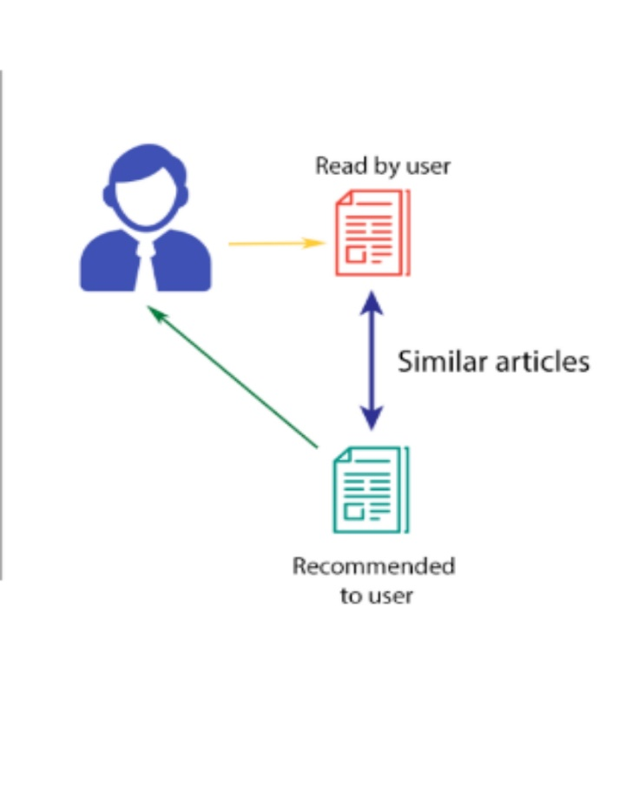
Content Based filtering (illustration)

Slide 14
Examples of content based recommender systems
Rotten Tomatoes
Internet Movie Database

Slide 15
Comparison between Collaborative and Content based filtering
 | Collaborative filtering | Content based filtering
How it works | Uses K-NN statistical model | Uses tf-idf applied to keyword
Assumption | Everyone behaves like thy neighbor | Online product comments are truthful
When is it used | Product information is not available | With social net, blogs etc

Slide 16
Hybrid Recommender System
Combines collaborative and Content based filtering
Netflix is a good example.
The website makes recommendation by comparing the watching and searching habits of similar users (ie, collaborative filtering) as well as by offering movies that share characteristics with films that a user has rated highly (content-based filtering)

Slide 17
In summary a recommendation engine works this way;
Collection of data
Storing the data
Analyzing the data
Filtering the data

